Slide 1


Slide 2

AUTONOMOUS INFRASTRUCTURE
BY
K.BHARATHY KATHIRVEL
MAILAM ENGINEERING COLLEGE
DT-NO:20206783739

Slide 3

TABLE OF CONTENT:
INTRODUCTION
PROBLEM STATEMENT
HARDWARE AND SOFTWARE USED
SQL SERVER DATABASE
CLOUD COMPUTING
LOAD BALANCER AND SUBNET
TECHNOLOGIES USED
FLOW CHART

Slide 4

PROBLEM STATEMENT:
One of the Retail customer is looking to automate various phases of Infrastructure Lifecycle i.e., Design, Build, Operate and Optimize. Overall objective of the Autonomous infrastructure are to improve agility of the business requirement and reduce manual intervention while managing the overall lifecycle of application

Slide 5

INTRODUCTION:
AUTONOMOUS IT is any kind of technology that can function without depending on any manual intervation . As the name defines here in this project the instance is created automatically when the traffic is more and gets reduced when the traffic is less.

Slide 6


SOFTWARE USED:
Operating System : Windows 10
Coding Language : ASP.Net with c#
Data base : SQL Server

Slide 7

SQL SERVER:
SQL Server is a database server by Microsoft. The Microsoft relational database management system is a software product which primarily stores and retrieves data requested by other applications. ... Therefore, a SQL Server is a database server that implements the Structured Query Language (SQL).

Slide 8

CLOUD COMPUTING
Cloud computing is the delivery of different services through the Internet. These resources include tools and applications like data storage, servers, databases, networking, and software.

Slide 9

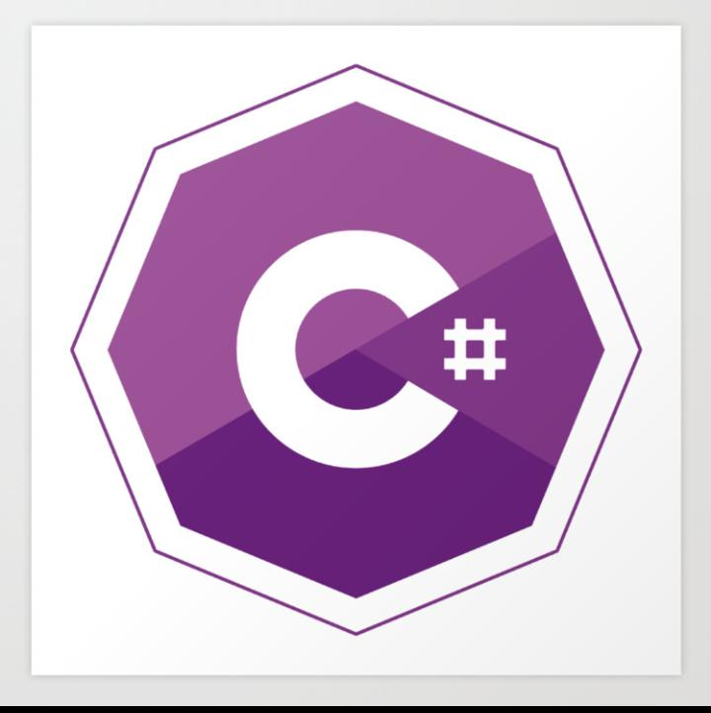



Slide 10
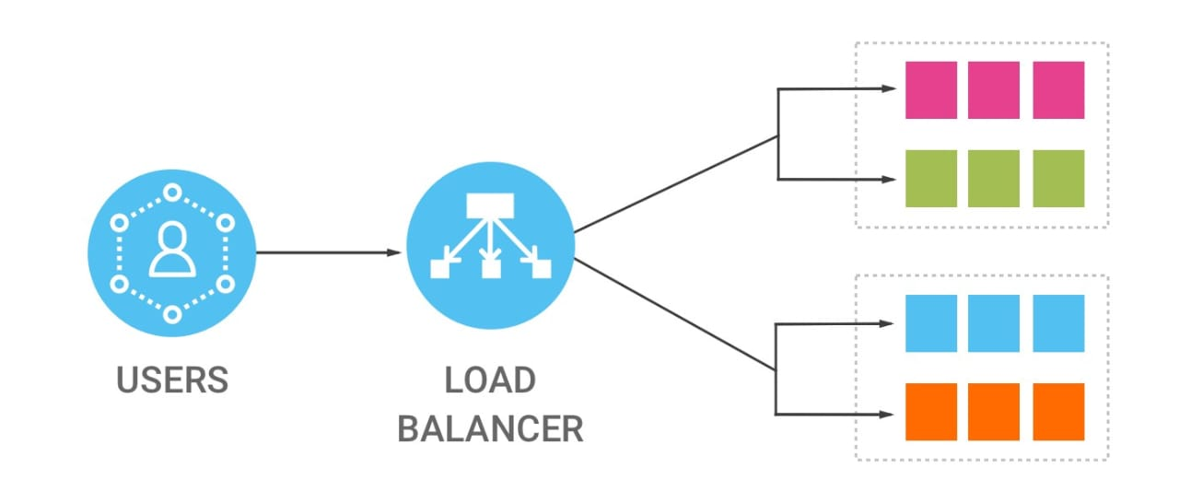
LOAD BALANCER:
The load balancing in database servers is a typical method which is executed to distribute the incoming network traffic and workload over multiple servers to diminish the downtime and increment the efficiency.
Each load balancer sits between client devices and backend servers, receiving and then distributing incoming requests to any available server capable of fulfilling them.

Slide 11

SUBNET
The practice of dividing a network into two or more networks is called subnetting.
A subnet, or subnetwork, is a segmented piece of a larger network. ... Organizations will use a subnet to subdivide large networks into smaller, more efficient subnetworks. One goal of a subnet is to split a large network into a grouping of smaller, interconnected networks to help minimize traffic.

Slide 12
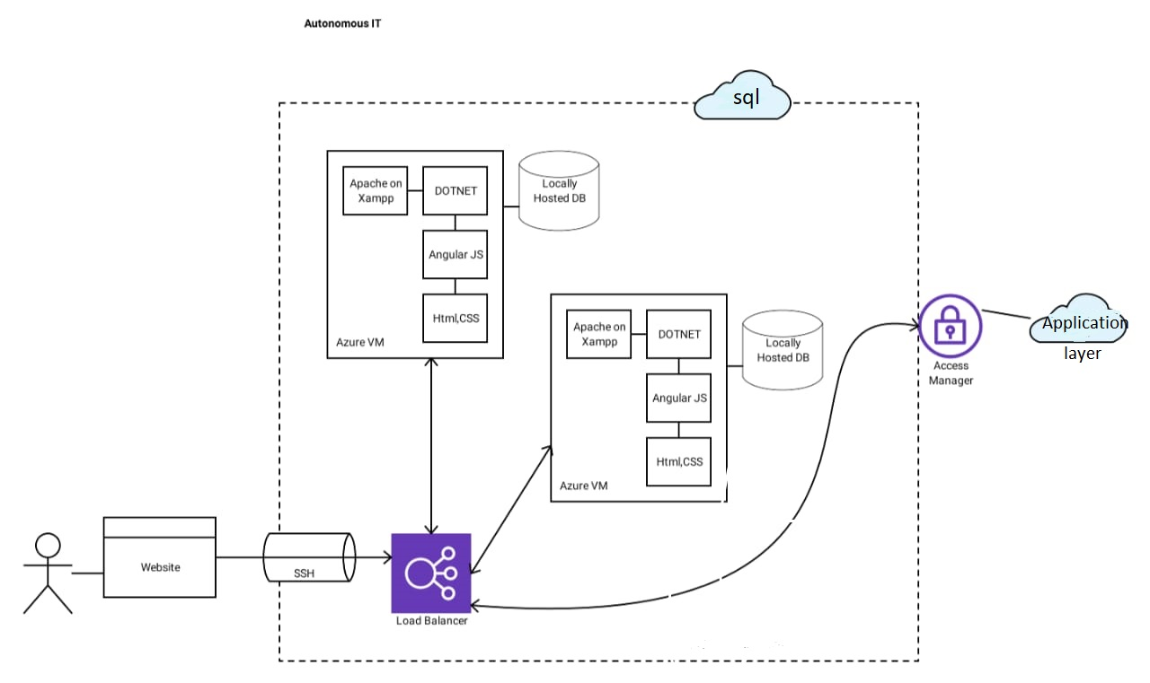
FLOW CHART:

